Slide 1
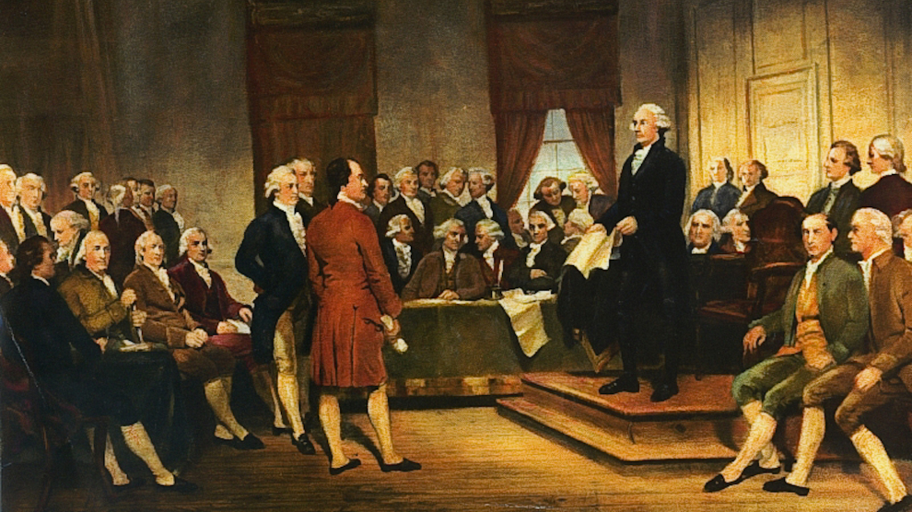
Charter Review Committee
October 14, 2021

Slide 2

Agenda
Introductions
Committee Purpose
Goal & Objectives
Timeline
Chair & Co-Chair and Meeting Schedule
Charter Issues

Slide 3
Introduction – City Staff
Dominic Lazzaretto, City Manager
Mike Bruckner, Deputy City Manager
Michael Maurer, Assistant City Attorney
Rachelle Arellano, Deputy City Clerk
Hazel Aguilar, Intern

Slide 4
Introduction – Committee Members
Sudhir Agrawal
Sheng Chang
James Helms, Jr.
Lee Kuo
Anthony Leung
Jagdeep Singh
Li Zhang

Slide 5
Why Are We Here
SB 415 required cities to consolidate elections with state
  Council adopted Ordinance No. 2352
  Redondo Beach decision
Article XI: Elections
  Change election from at-large to by district and from April to November

Slide 6
Committee Purpose
The purpose of the Committee is to review and make recommendations for updating the City’s Municipal Charter in accordance with state/federal law and for 21st century governance standards.

Slide 7
Goal & Objectives
Goal: Committee has 6 months to make recommendations for Charter amendments
Objectives: Staff has prepared a list of items that are priority for the Committee to consider

Slide 8
Timeline
October 2021 – March 2022 (if needed): Committee review
April/May 2022: Report to City Council
May/June 2022: Council approves proposed Charter amendments
June/July 2022: Council approves resolution for ballot measure
  Must be done 88 days prior to November 8, 2022
July – November 2022: Public information and outreach
November 8, 2022: Election day

Slide 9
Chair & Co-Chair and Meetings
Appointment of Chair and Co-Chair by majority vote
How often and when would the Committee like to meet?

Slide 10
Charter Issues
General Language Clean-up
  Replace gender pronouns (his/her/chairman) with their/they/chairperson
  Section 603: Change Manager Pro Tempore to Assistant City Manager (and page. 21)
  Provisions Inconsistent with State/Federal Law

Slide 11
Charter Issues
Section 401: City Council Eligibility
  Term Limits
Section 402: City Council Compensation
  Set by Ordinance
Section 404: Mayor & Mayor Pro Tempore
  City Council Reorganization Date Change

Slide 12
Charter Issues
Section 417: Adoption of Codes by Reference
  Allowance for online posting; eliminate need for 3 copies
Section 420: Publishing of Legal Notices
  Allowance for online publishing; are Newspapers still relevant?

Slide 13
Charter Issues
Section 808: Human Resources Commission
  Allow the City Manager to change personnel classifications; exist to solely hear grievances
Section 809: Library Donations
  Allow for donations up $10,000 to be accepted administratively
Article XI: Elections
  Change election from at-large to by district and from April to November

Slide 14
Charter Issues
Section 1203: Capital Program
  Change limit of capital improvement
Section 1212: Contracts on Public Works
  Change limit on expenditures
Article XIV: Board of Education
  Remove

Slide 15
Charter Issues for Consideration
Preamble
  Do you want to update it to reflect the City’s values?
Design Immunity
  Under Government Code 830.6, design immunity is an affirmative defense for plans that were approved in advance by the legislative body of the public entity, “or other body or employee exercising discretionary authority to give such approval.”

Slide 16
Charter Issues for Consideration
New Sports Betting Tax
  Proposition in November 2022 would impose 10% tax on sports-wagering profits at horse-racing tracks; no revenue to cities
Transient Occupancy Tax Increase
  Current rate is 10%; recommendation would be to increase to 12%-14%

Slide 17
Next Steps
Review City Charter
Each meeting we will discuss potential changes to various items
Staff recommended that the Committee vote on each item separately

